Slide 1
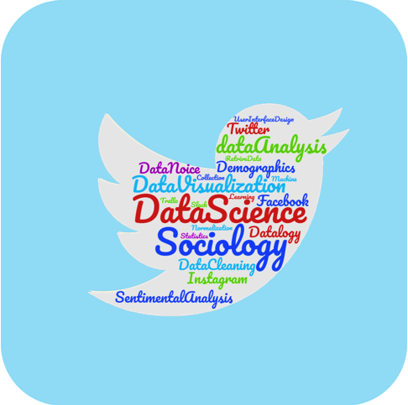
Socio Analyzer
Client : Dr. Kyoung-Ho Shin
Team MI 7
Abhijeet Agrawal
Durga Charan Potukuru
Krishna Veni Karri
Srinivas Prakash Pakala Sai Praneetha Jaladanki
Vipul Chandoor
1

Slide 2

Outline
Introduction
Problem statement
Proposed solution
Tools and techniques
Workflow
E-R diagram
Demo
Sentiment analysis
Future tasks
Limitations
2

Slide 3
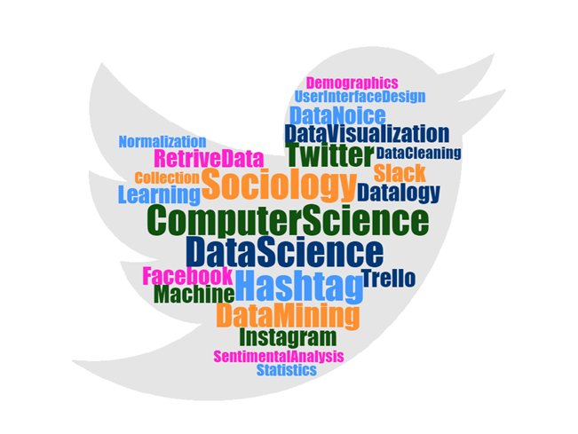
Introduction
3
Vipul Chandoor

Slide 4
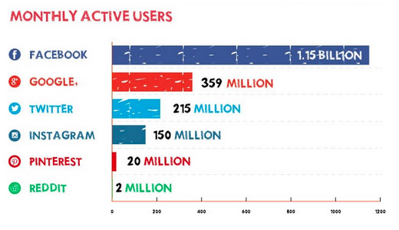

Problem statement
4
Praneetha Jaladanki

Slide 5



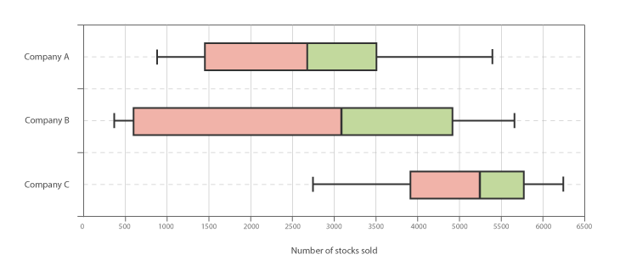
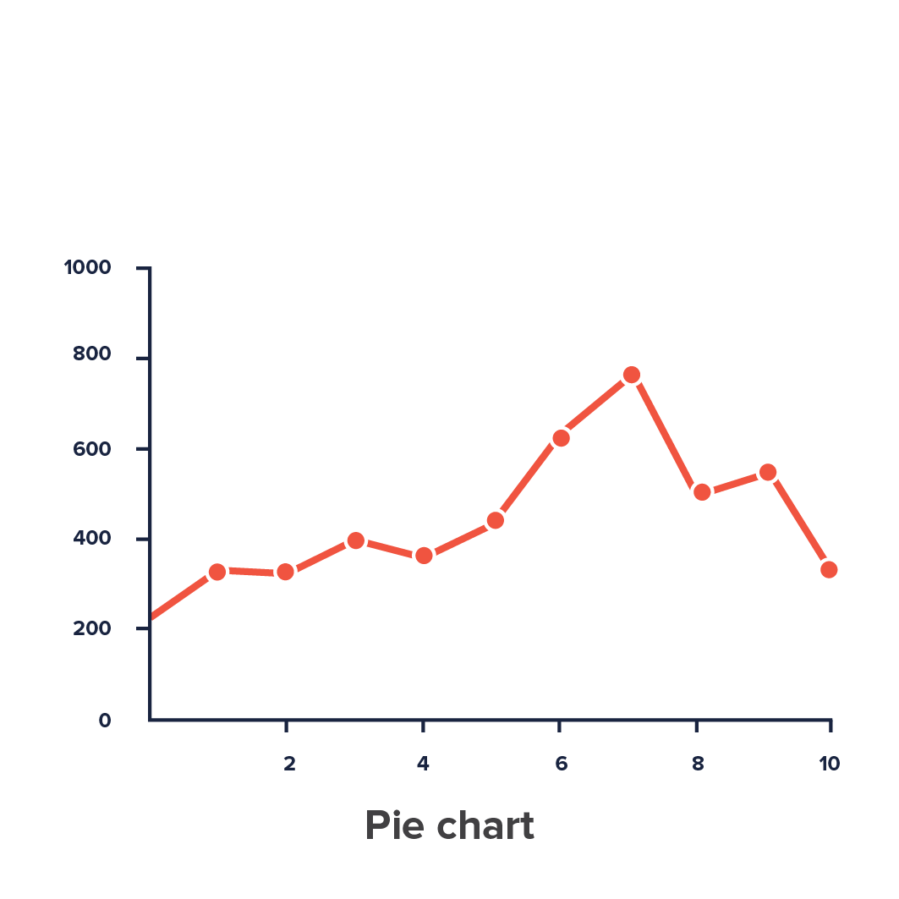
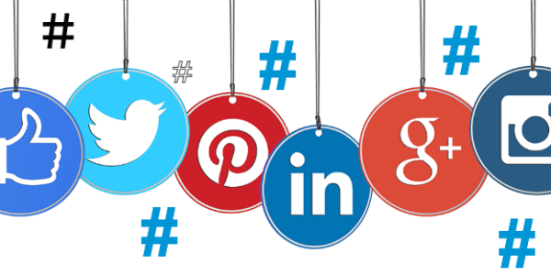
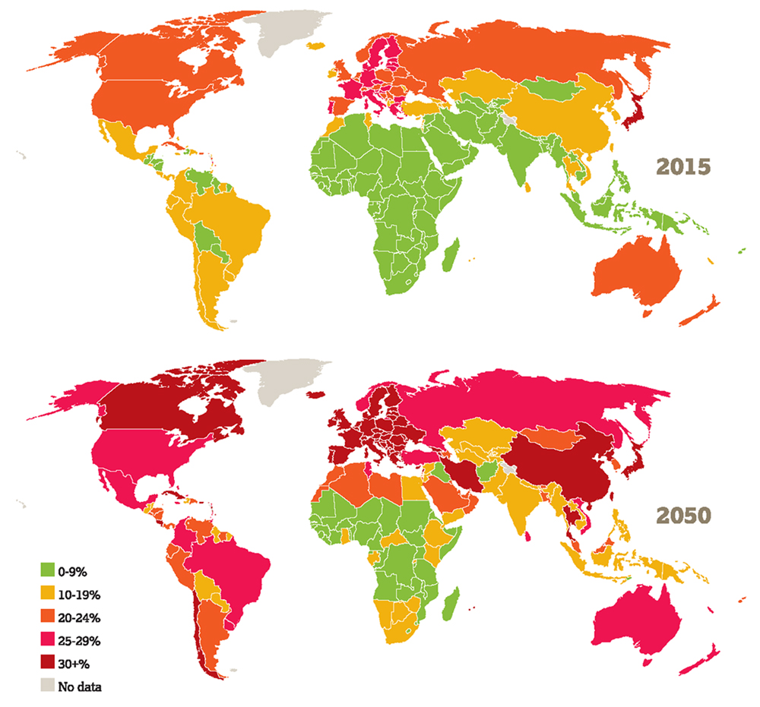
Proposed solution
5
Praneetha Jaladanki

Slide 6
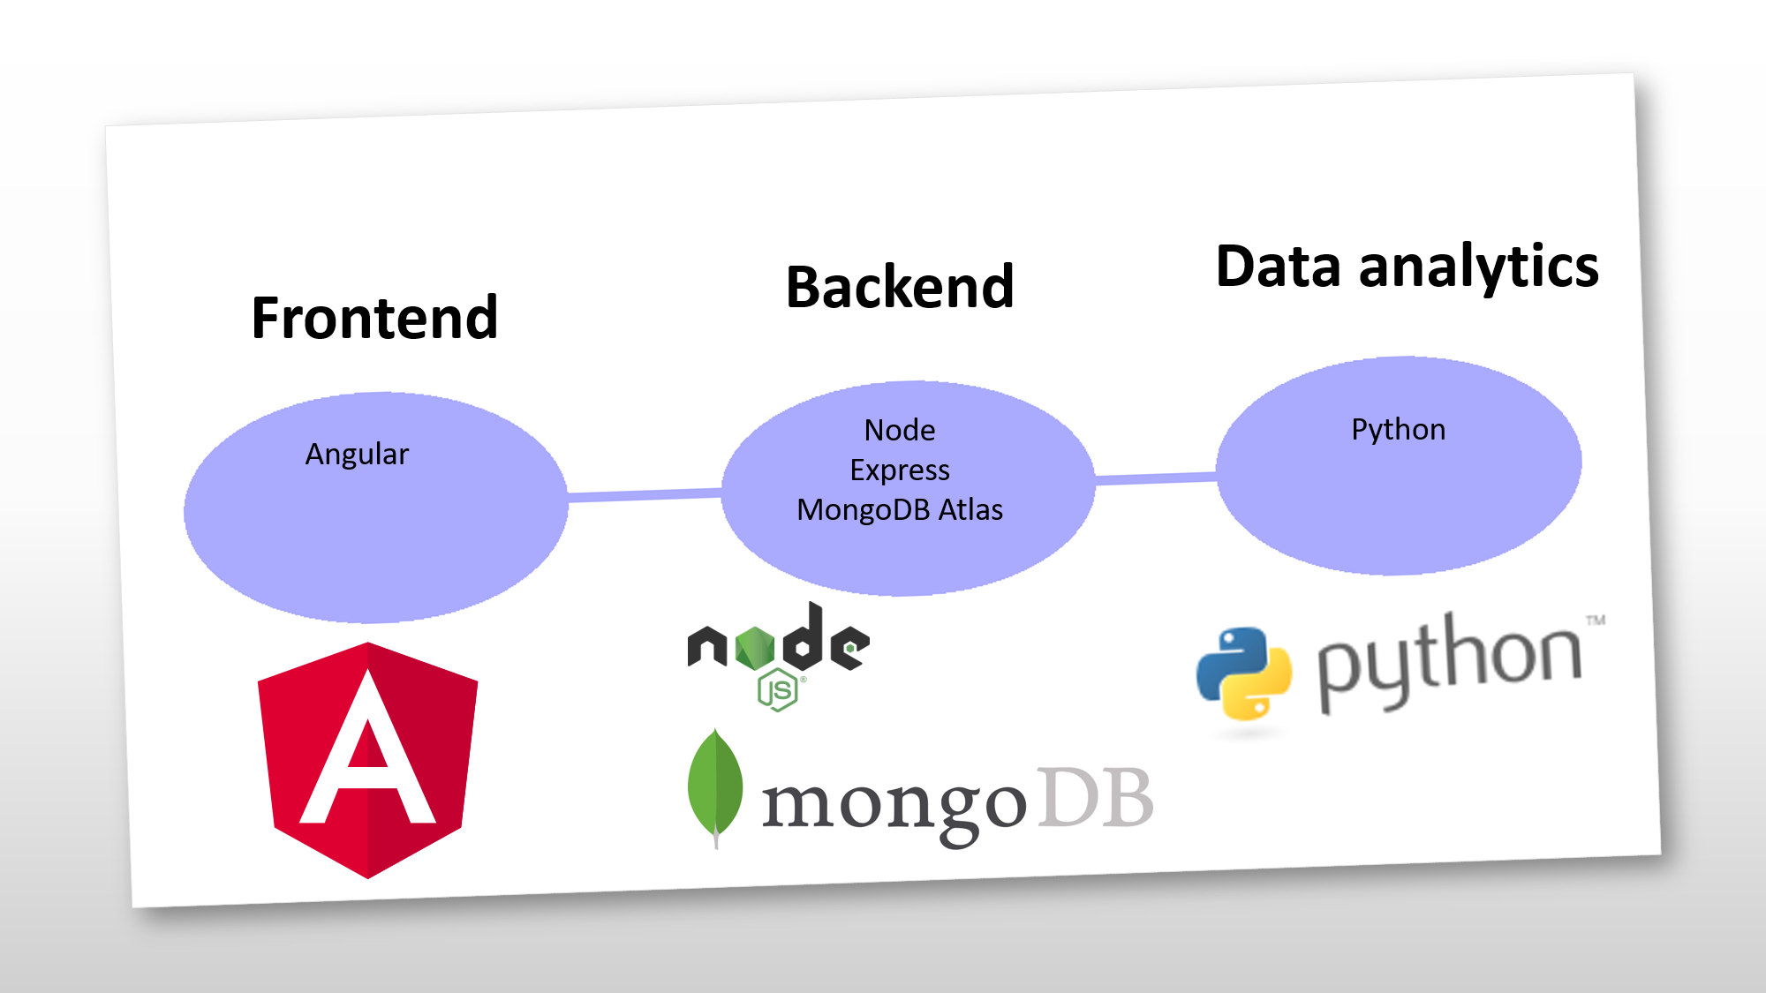
Tools and technologies
6
Durga Charan Potukuru

Slide 7
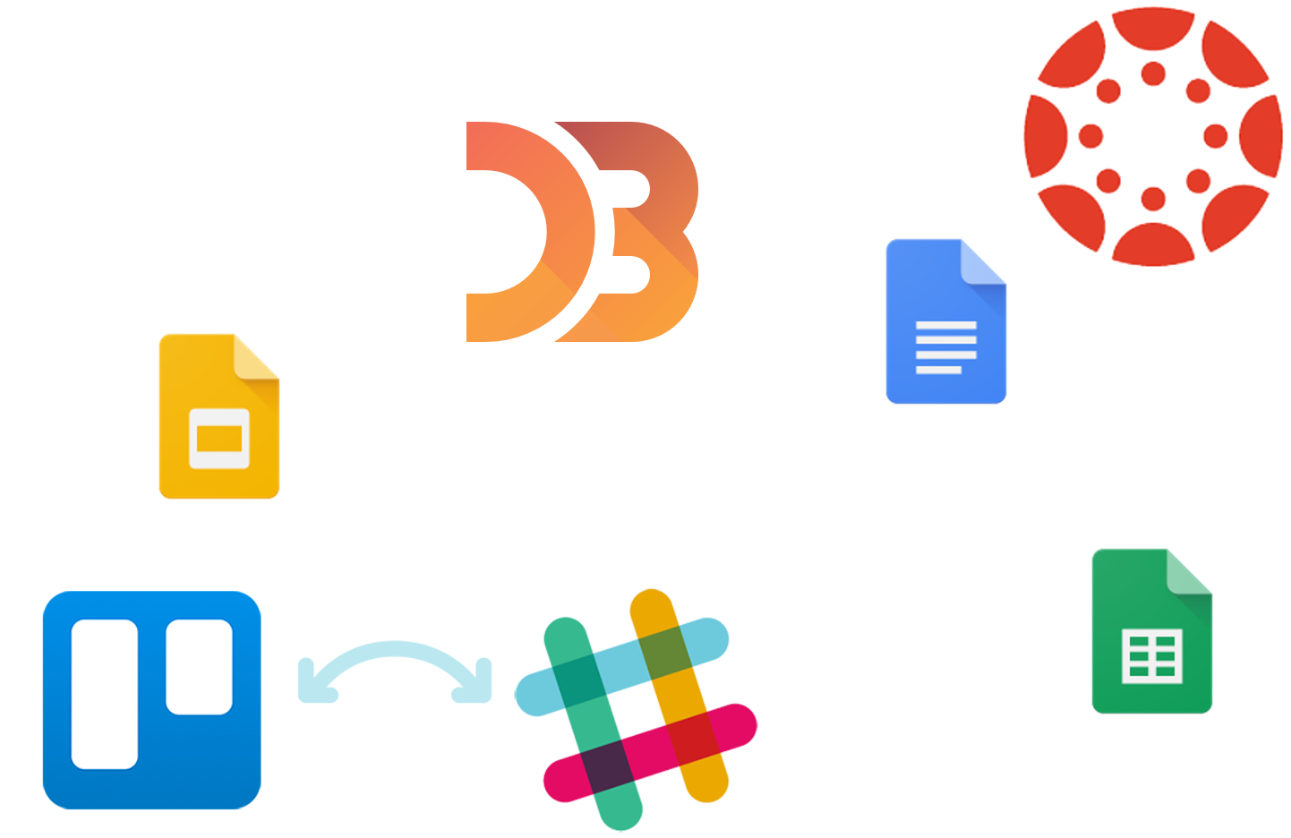

Other tools
Github
Slack
Trello
Google docs
Canvas
D3.js
7
Durga Charan Potukuru

Slide 8
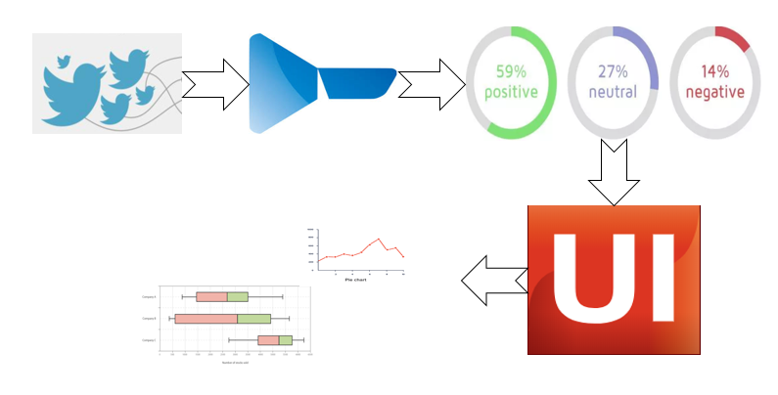
Work-Flow
9
Krishna Veni Karri

Slide 9
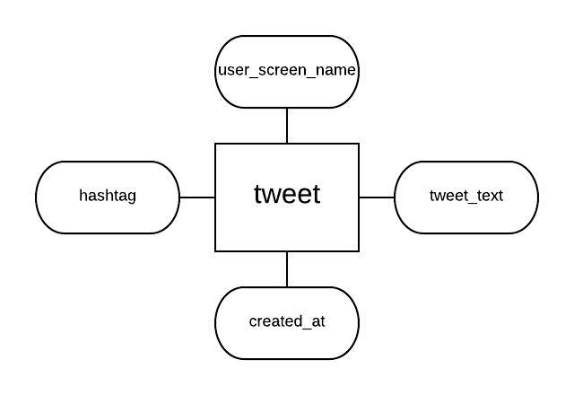
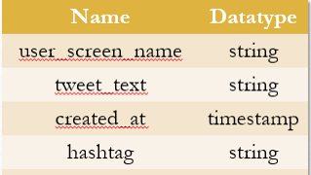
Database design
Collection: Tweet
Attributes:
10
Krishna Veni Karri

Slide 10
Demo time
11
Abhijeet Agrawal & Durga Charan Potukuru

Slide 11
Sentiment analysis
8
Durga Charan Potukuru

Slide 12

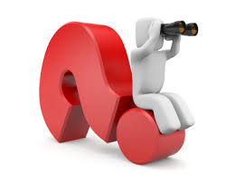
Future tasks
Sentiment analysis
Frontend development
Database design and connectivity
Data visualization
12
Srinivas Prakash Pakala

Slide 13
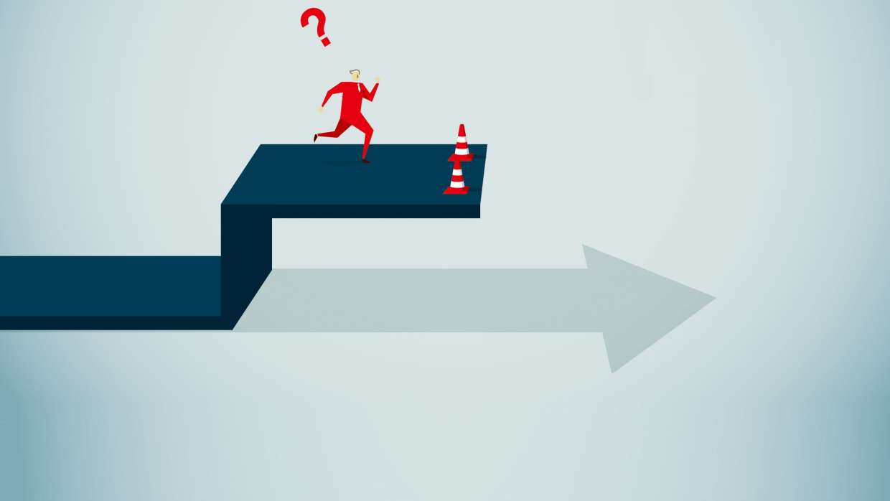
Limitations
No access to demographic data like age of the person, location, gender etc.
Expensive historic data
Cannot retrieve data from other social media
Storage of historic data
13
Srinivas Prakash Pakala

Slide 14
14

